Slide 1
Long-Mann 16-Bit RISC Processor
Final DESIGN REVIEW presentation

Slide 2
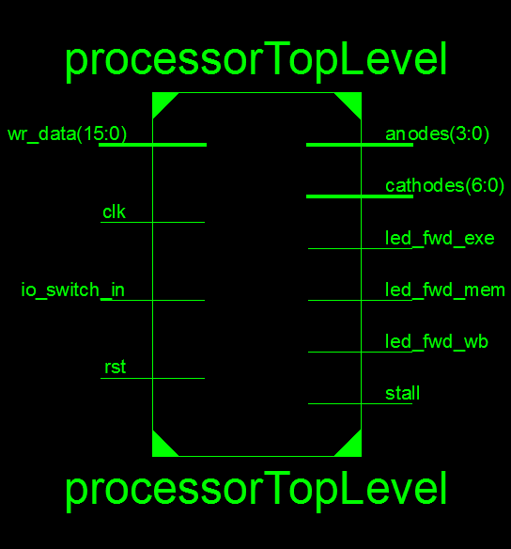
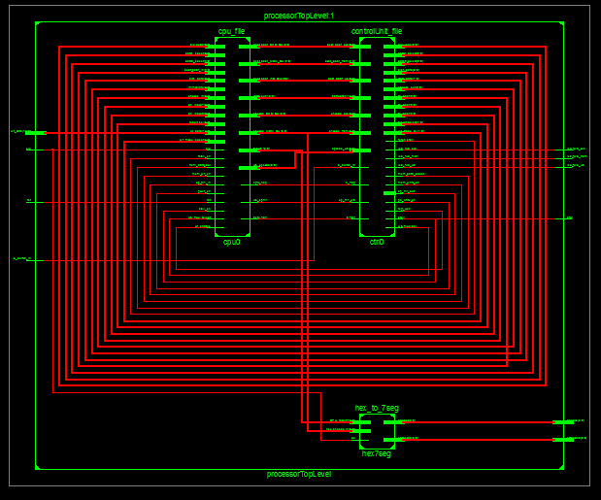
High Level Overview
Hierarchy and RTL SCHEMATIC

Slide 3
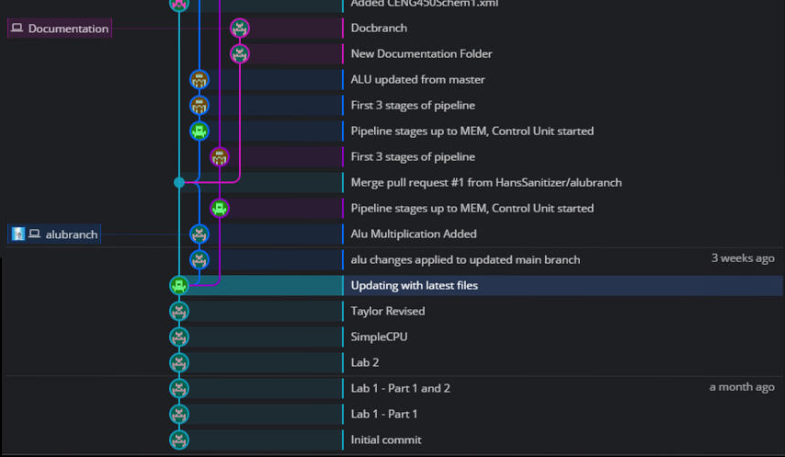
Development Timeline – Note (will remove later): These times in reference to 9pm 3/26/2017
FIRST STEPS – SIMPLE CPU, ALU, AND PIPELINE STAGES

Slide 4
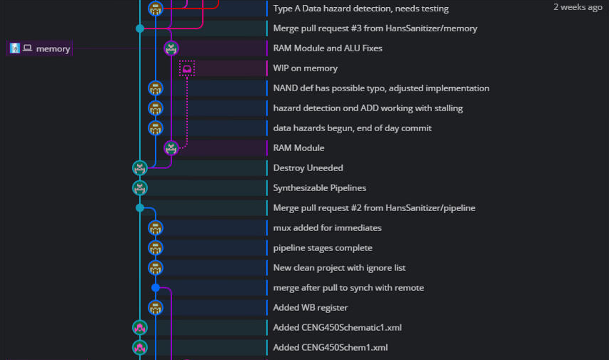
Development Timeline
FINISHING PIPELINE STAGES, RAM MODULE, BEGINNING HAZARDS

Slide 5
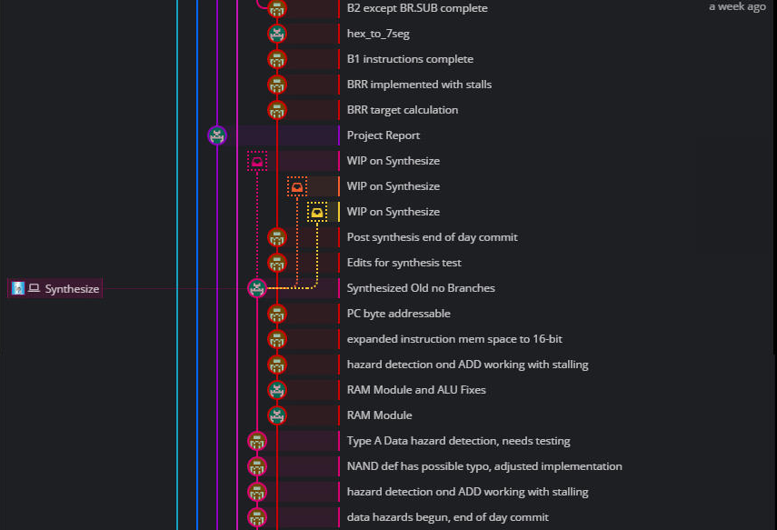
Development Timeline
FINISHING HAZARD DETECTION, STARTING BRANCH INSTRUCTIONS, STARTING USER I/O

Slide 6
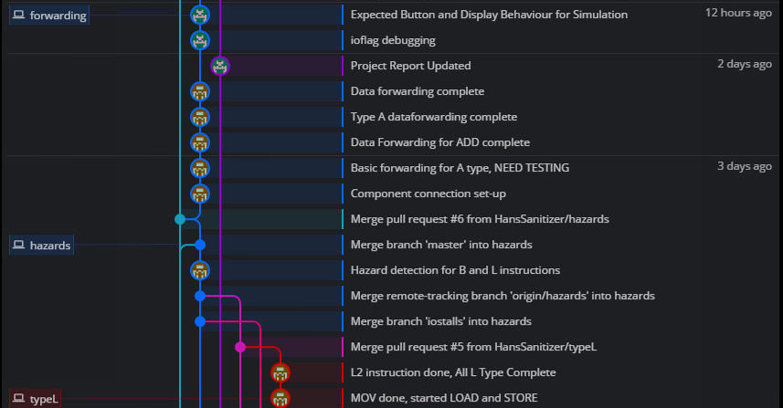
Development Timeline
FINISHING L INSTRUCTIONS, USER I/O DEBUGGING, DATA FORWARDING

Slide 7
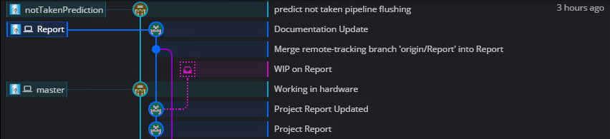
Development Timeline
FINAL TOUCHES – BRANCH PREDICTIONS, PROJECT REPORT WRITING

Slide 8
Looking Back – All Goals Met
Add your first bullet point here
Add your second bullet point here
Add your third bullet point here

Slide 9
Title and Content Layout with Chart

Slide 10
Two Content Layout with Table
First bullet point here
Second bullet point here
Third bullet point here
Class | Group 1 | Group 2
Class 1 | 82 | 95
Class 2 | 76 | 88
Class 3 | 84 | 90

Slide 11
Two Content Layout with SmartArt
First bullet point here
Second bullet point here
Third bullet point here
Task 1
Task 2
Task 3

Slide 12
Add a Slide Title - 2

Slide 13
Add a Slide Title - 3

Slide 14
Add a Slide Title - 4

Slide 15
Add a Slide Title - 5

